Slide 1
Introduction of Computer
Networks
Lecture -1 (Theory)
Dr. Htet Ne Oo
Department of Computer Science and Engineering,
Chitkara University, Punjab

Slide 2
Index
,
Uses of Computer Networks
Network Topologies
Collision Domain
Broadcast Domain

Slide 3
Different Types of Computer Networks
The classification of network in computers can
be done according to their
i) Size : expressed by the geographic area and number of computers
ii) Purpose : devices housed in a single room to millions of devices spread across the world.

Slide 4
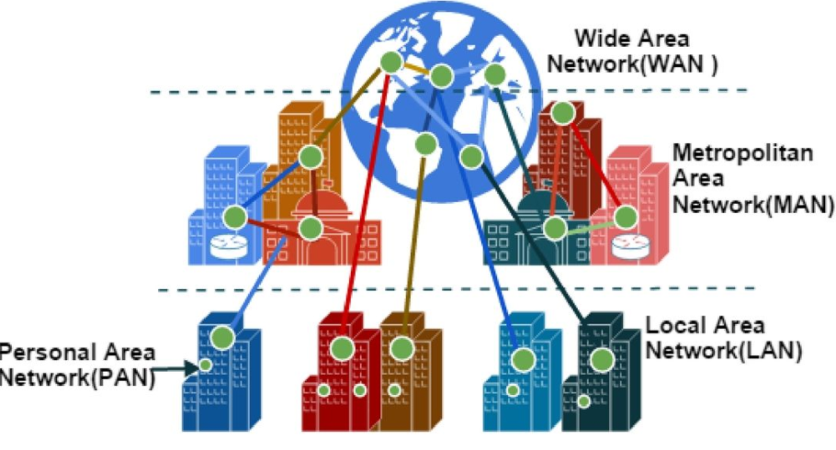
Types of Computer Networks

Slide 5
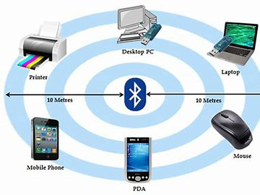
Personal Area Network
PAN (Personal Area Network) is a computer network formed around a person.
Characteristics of PAN
Below are the main characteristics of PAN:
It is mostly personal devices network equipped within a limited area.
Appliances use for PAN: cordless mice, keyboards, and Bluetooth systems.

Slide 6
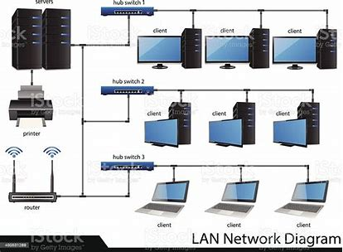
Local Area Network
A group of computer and peripheral devices which are connected in a limited area such as school, laboratory, home, and office building.
The simplest type of LAN network is to connect computers and a printer in someone’s home or office.

Slide 7
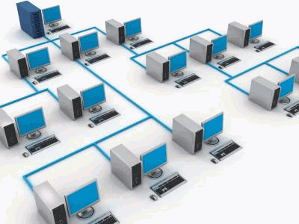
Local Area Network
Characteristics of LAN
Here are the important characteristics of a LAN network:
It is a private network, so an outside regulatory body never controls it.
LAN operates at a relatively higher speed compared to other WAN systems.

Slide 8
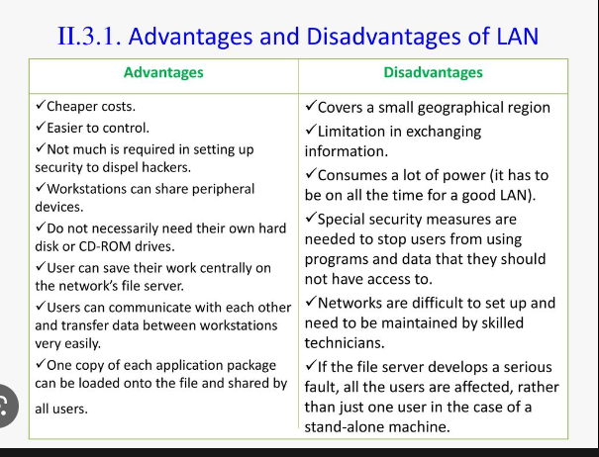
Advantages and Disadvantages of LAN

Slide 9
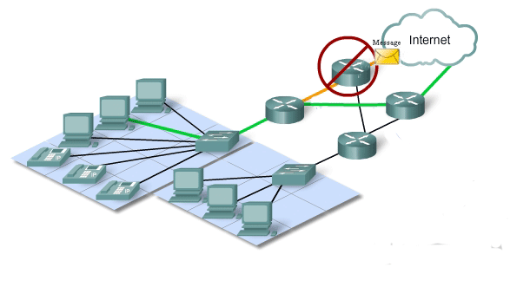
WAN:Wide Area Network
WAN is another important computer network that which is spread across a large geographical area.

Slide 10
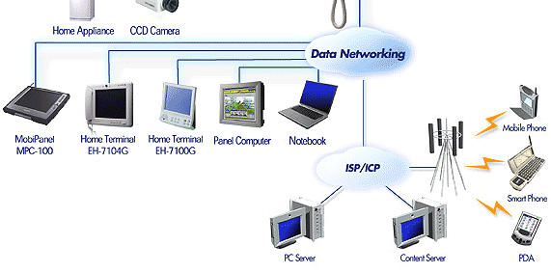
Network Components
End Devices : PC, Laptop, Mobile
Connecting Devices: Hubs, Switches, Routers
Transmission Media: Wired, Wireless Media
Software: Operating Systems for PCs and Connecting Devices

Slide 11
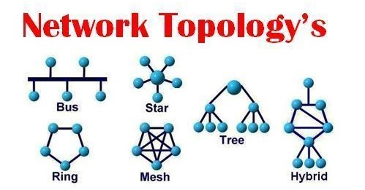
Topologies
The Physical or Logical layout of a network is known as Topology of the network.
It can be divided into:
i) Physical Topology
ii) Logical Topology

Slide 12
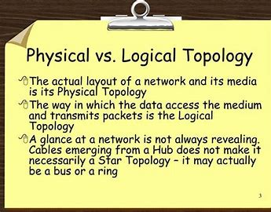
Topologies

Slide 13
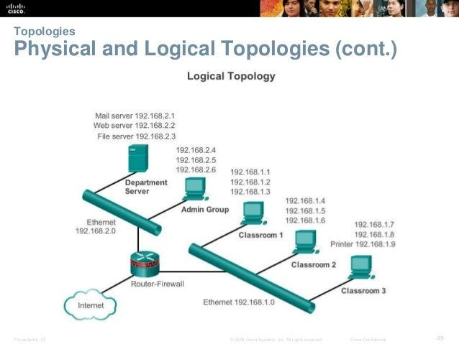

Slide 14
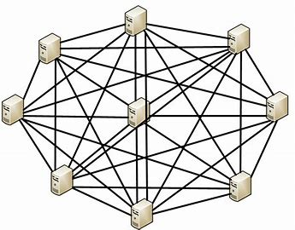
Mesh Topology
In a mesh topology, every device is connected to another device via a particular channel.
Every device is connected with another via dedicated channels. These channels are known as links.

Slide 15
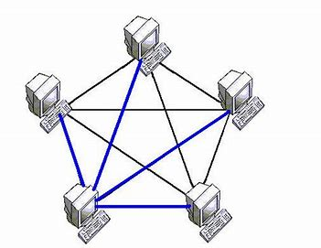
Mesh Topology
Suppose, N number of devices are connected with each other in a mesh topology, the total number of ports that are required by each device is N-1.
In Figure 1, there are 5 devices connected to each other, hence the total number of ports required by each device is 4. Total number of ports required=N*(N-1).
Suppose, N number of devices are connected with each other in a mesh topology, then the total number of dedicated links required to connect them is ^{N}C₂ i.e. N(N-1)/2. In Figure 1, there are 5 devices connected to each other, hence the total number of links required is 5*4/2 = 10.

Slide 16
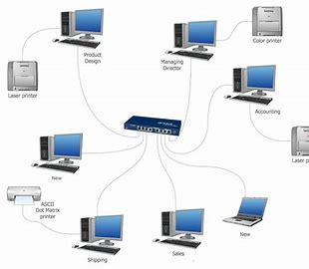
Star Topology
In star topology, all the devices are connected to a single networking device through a cable. This central device may be hub, switch, router and all other nodes are connected to the central node.

Slide 17
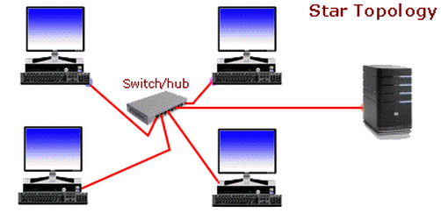
Star Topology
Advantages of this topology :
If N devices are connected to each other in a star topology, then the number of cables required to connect them is N. So, it is easy to set up.
Each device requires only 1 port i.e. to connect to the hub, therefore the total number of ports required is N.
Problems with this topology :
If the concentrator (hub) on which the whole topology relies fails, the whole system will crash down.
The cost of installation is high.
Performance is based on the single concentrator i.e. hub.

Slide 18
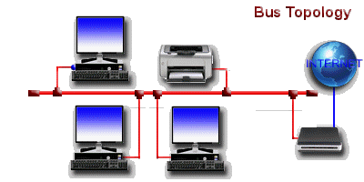
Bus Topology
Bus topology is a network type in which every computer and network device is connected to a single cable. It transmits the data from one end to another in a single direction. No bi-directional feature is in bus topology.

Slide 19
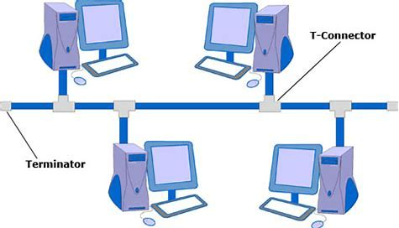
Bus Topology
Advantages of this topology :
If N devices are connected to each other in a bus topology, then the number of cables required to connect them is 1, which is known as backbone cable, and N drop lines are required.
The cost of the cable is less as compared to other topologies, but it is used to build small networks.
Problems with this topology :
If the common cable fails, then the whole system will crash down.
If the network traffic is heavy, it increases collisions in the network. To avoid this, various protocols are used in the MAC layer known as Pure Aloha, Slotted Aloha, CSMA/CD, etc.
Security is very low.

Slide 20
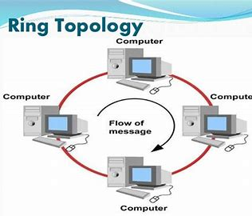
Ring Topology
In this topology, it forms a ring connecting devices with its exactly two neighboring devices.
A number of repeaters are used for Ring topology with a large number of nodes, because if someone wants to send some data to the last node in the ring topology with 100 nodes, then the data will have to pass through 99 nodes to reach the 100th node. Hence to prevent data loss repeaters are used in the network.
The transmission is unidirectional, but it can be made bidirectional by having 2 connections between each Network Node, it is called Dual Ring Topology.

Slide 21
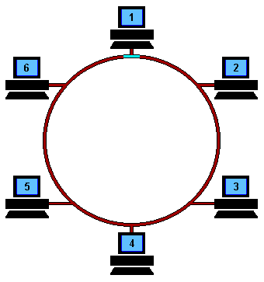
Ring Topology
The following operations take place in ring topology are :
One station is known as a monitor station which takes all the responsibility to perform the operations.
To transmit the data, the station has to hold the token. After the transmission is done, the token is to be released for other stations to use.
When no station is transmitting the data, then the token will circulate in the ring.
There are two types of token release techniques: Early token release releases the token just after transmitting the data and Delay token release releases the token after the acknowledgment is received from the receiver.

Slide 22
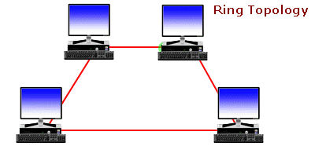
Ring Topology
Advantages of this topology :
The possibility of collision is minimum in this type of topology.
Cheap to install and expand.
Problems with this topology :
Troubleshooting is difficult in this topology.
The addition of stations in between or removal of stations can disturb the whole topology.
Less secure.

Slide 23
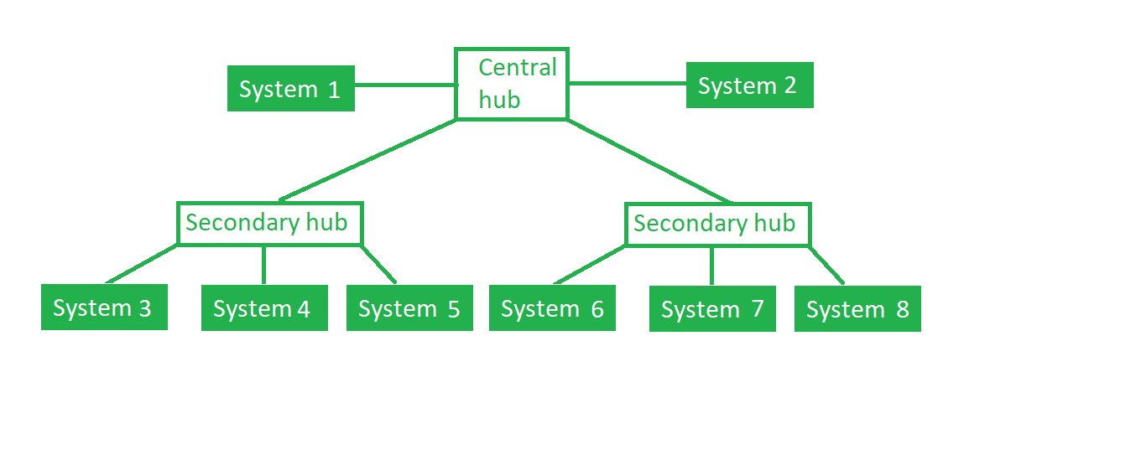
Tree Topology
This topology is the variation of Star topology. This topology has a hierarchical flow of data.

Slide 24
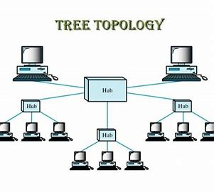
Tree Topology
In this, the various secondary hubs are connected to the central hub which contains the repeater. In this data flow from top to bottom i.e. from the central hub to secondary and then to the devices or from bottom to top i.e. devices to the secondary hub and then to the central hub.

Slide 25
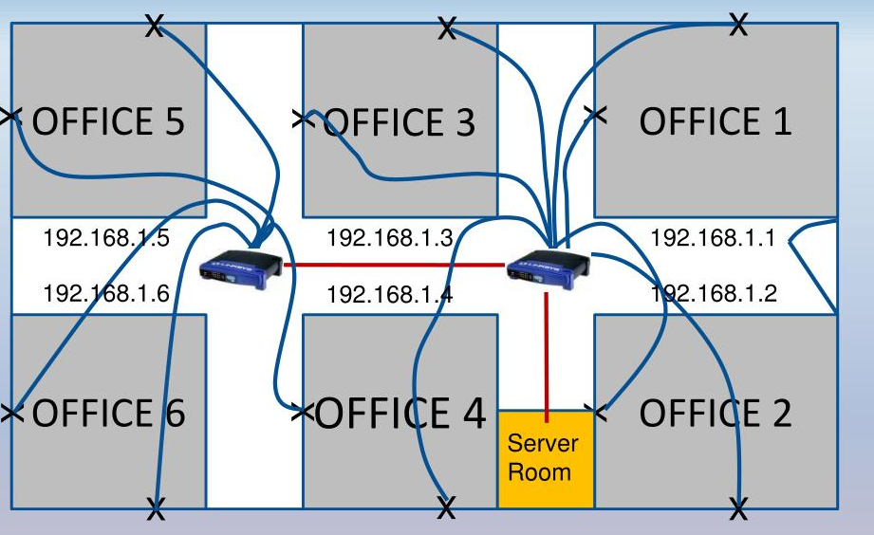
Tree Topology

Slide 26
Topology
Advantages of this topology :
It allows more devices to be attached to a single central hub thus it decreases the distance that is traveled by the signal to come to the devices.
It allows the network to get isolate and also prioritize from different computers.
Problems with this topology :
If the central hub gets fails the entire system fails.
The cost is high because of cabling.

Slide 27
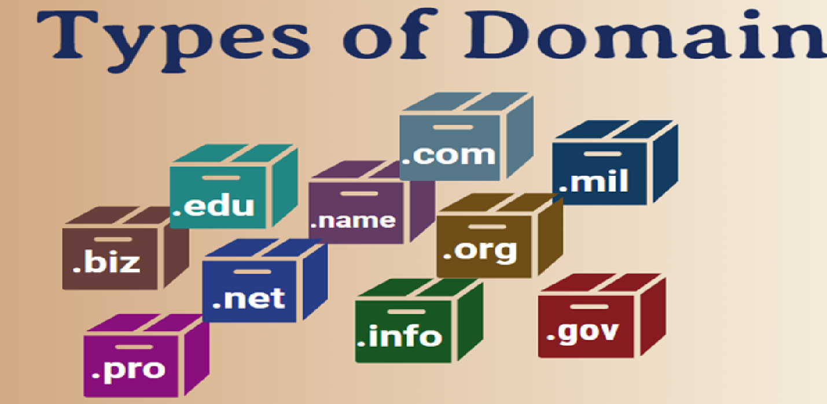
What is Domain?
A domain is a type of computer network in which all user computers, printers accounts, and other devices registered.
It is a central database located on single or multiple clusters of central computers, that is known as domain controllers.

Slide 28
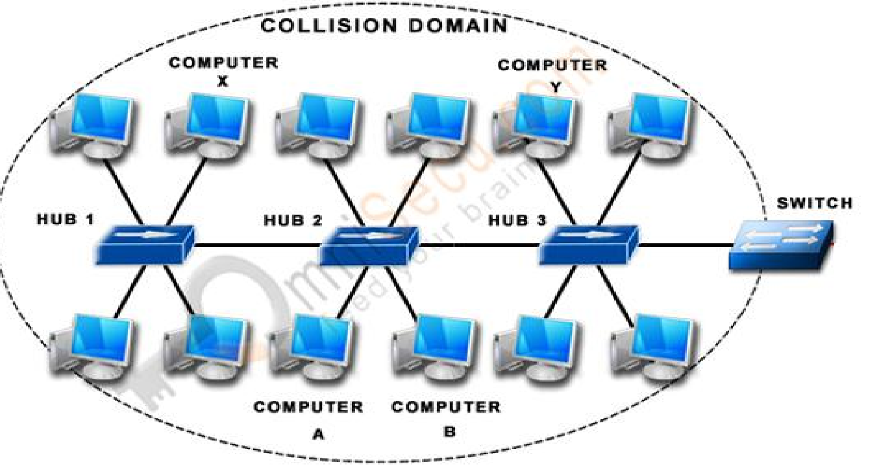
Collision Domain
Collisions will happen in an Ethernet Network when two devices simultaneously try to send data on the Shared Media, since Shared Media is half-duplex and sending and receiving is not supported at same time.
Collisions are a normal part of life in an Ethernet network when Ethernet operates in Half-duplex and under most circumstances should not be considered as a problem.
A Collision Domain is any network segment in which collisions can happen (usually in Ethernet networks). In other words, a Collision Domain consists of all the devices connected using a Shared Media (Bus Topolgy or using Ethernet Hubs) where a Collision can happen between any device at any time.

Slide 29
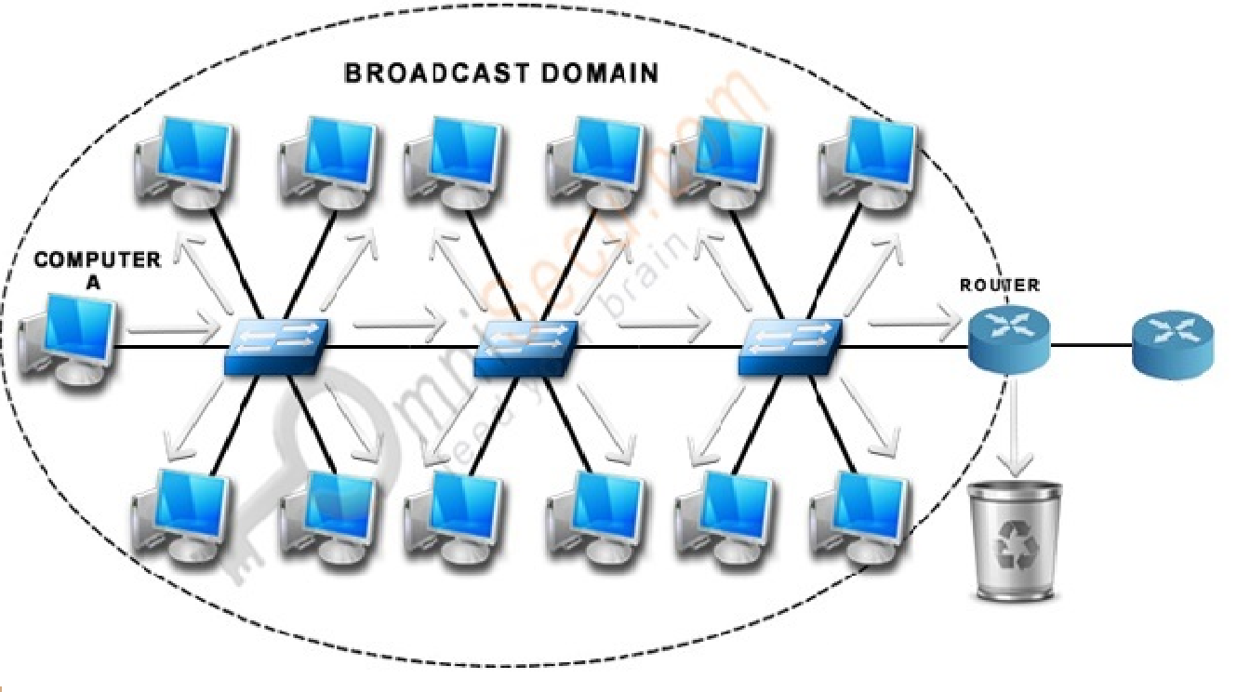
Broadcast Domain
Broadcast is a type of communication, where the sending device send a single copy of data and that copy of data will be delivered to every device in the network segment. Broadcast is a required type of communication and we cannot avoid Broadcasts, because many protocols (Example: ARP and DHCP) and applications are dependent on Broadcast to function.
A Broadcast Domain consists of all the devices that will receive any broadcast packet originating from any device within the network segment.
In Mention picture, "Computer A" is sending a broadcast and switch will forward it to every ports and all the switchs will get a copy of broadcast packet. Every switch will flood the broadcast packet to all the ports. Router also will get a copy of broadcast packet, but the Router will not forward the packet to the next network segment.
As the number of devices in the Broadcast Domain increases, number of Broadcasts also increases and the quality of the network will come down.

Slide 30
Difference Between Collision and Broadcast Domain
Collision Domain | Broadcast Domain
The Collision domain is a network section that allows traffic to flow forward and backward. | A Broadcast domain is a type of Domain wherein traffic flows all over the network.
The Collision domain refers to a set of devices in which packet collision could occur. | Broadcast domain refers to a logical set of reachable computer systems without using a router.
The devices might include the devices of other IP subnetworks. | Broadcast Domain is never limited to the specific IP subnetwork for all types of IP broadcasts.
Packet collision occurs as multiple devices transmit data on a single wire link. | The broadcast domain mostly uses a switched environment to broadcast, so no collision occurs.
Switches will break in the collision domain. | Switches will never break in the broadcast domain.
In, collision domain, every port on a router are in the separate broadcast domains. | All ports on a switch or a hub likely to be in the same broadcast domain.

Slide 31
THANK YOU

Slide 32
BREAK TIME

